Slide 1
Regression (October 2021)
Metis – Data Science Flex Module 2

Slide 2
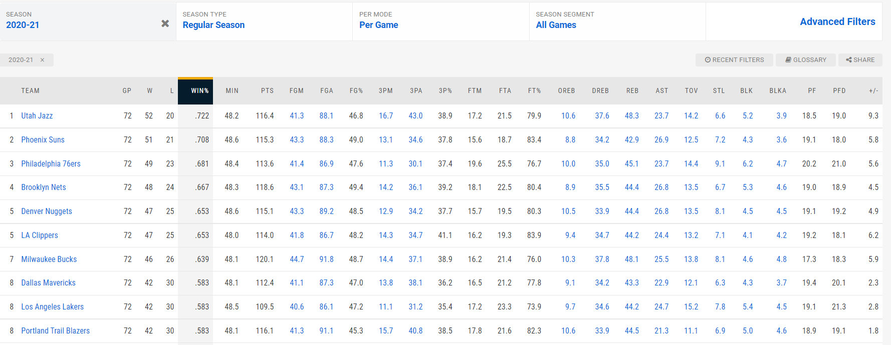
Concept
Can you predict Win % for an NBA team based on their per game stats?
Text
Source: https://www.nba.com/stats/teams/traditional/?sort=W_PCT&dir=-1&Season=2020-21&SeasonType=Regular%20Season

Slide 3
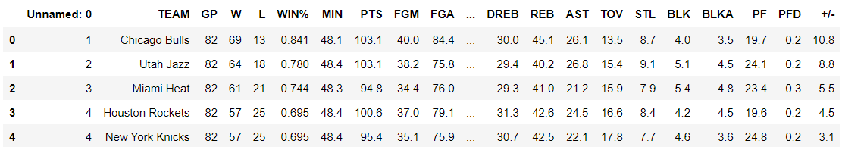
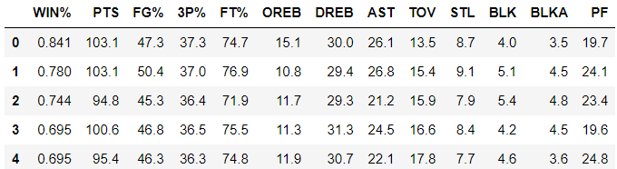
Exploratory Data Analysis
28 Features
12 Features

Slide 4
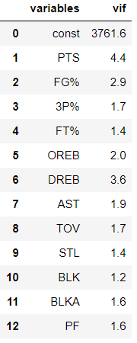

Selection criteria of the features within the data
Two key selection dimensions
The P-Value (probability value) is a number describing how likely a given data would have occurred by random chance.
P-Values
A p-value less than 0.05 is considered statistically significant.
Measures if one predictor variable in a regression model can be linearly predicted from the others with a substantial degree of accuracy.
A variance inflation factor of greater than 5-10 is an indicator of significant multicollinearity.
Multicollinearity
Final Data Set
12 Features

Slide 5
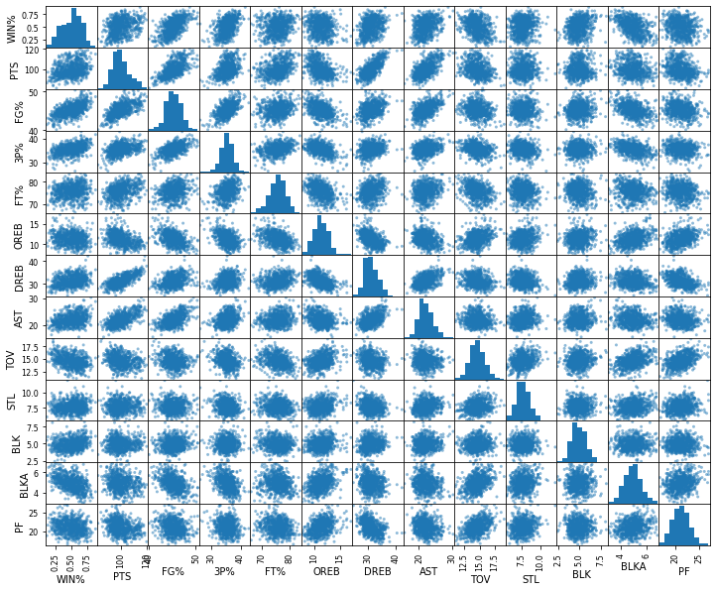
Scatter Matrix – Illustrates there is minimal relationship between features.

Slide 6
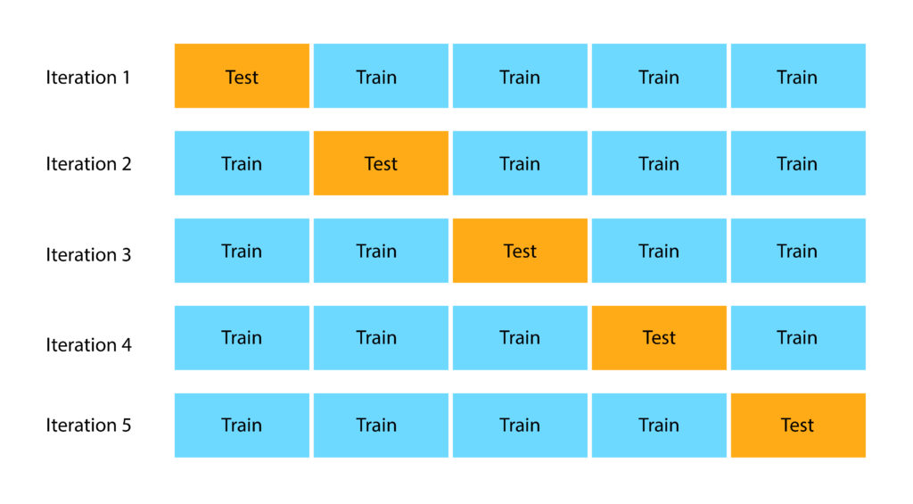

Methodology – Cross Validation (K=5)
Segregated features into an 80/20 split of training vs testing data.
Standardized data set.
Ran 3 regression models:
Linear Regression
Ridge Regression
LASSO Regression
Used Kfolds to cross-validate training data set (K=5)
Cross-Validation Results:

Slide 7
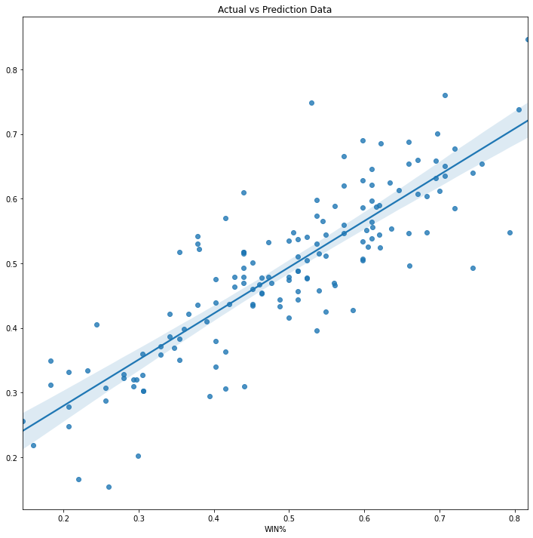
Final Results
Top 5 Statistically Significant Categories (Coefficients):
STL (0.0673)
FG% (0.0602)
DREB (0.0412)
OREB (0.0407)
3P% (0.0186)
Mean Absolute Error: 0.0063
R-Squared: 0.7196
Text

Slide 8
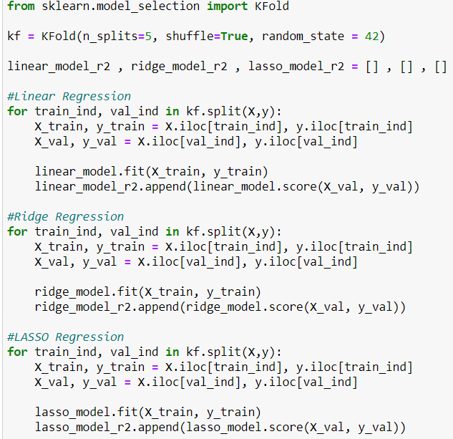
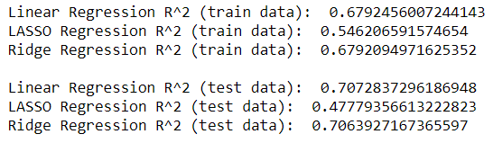

Appendix
R-Squared calculations after standardized data
Cross Validation (K=5) R-Squared
Cross-Validation Code

Slide 9
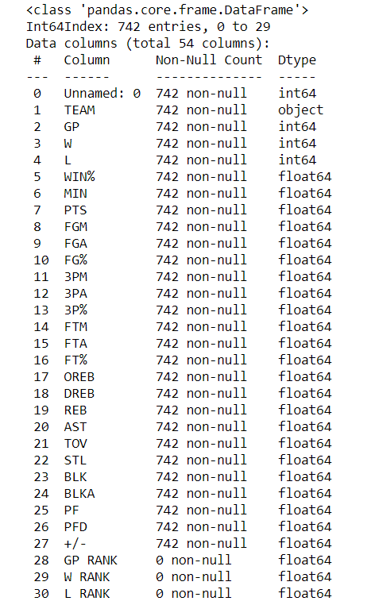
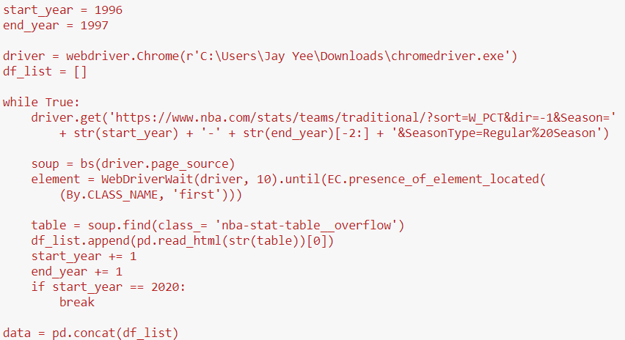
Appendix
Webscraping code
*Code also webscraped ‘RANK’ columns that had empty values. These were not considered during analysis

